Slide 1
Cartoonify Images with a QR scanner
by using python and machine learning

Slide 2
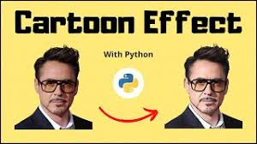

Slide 3
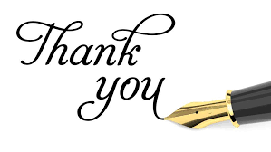
Acknowledgment
It gives us great pleasure to present the report of the B.Tech mini project (Cartoonify Image) undertaken during B. Tech III Year. This project is going to be an acknowledgment of the inspiration, drive, and technical assistance that will be contributed to it by many individuals.
I owe a special debt of gratitude to Mrs.RuchiTalwar(Assistant Professor Department of CEA), for providing me with an encouraging platform to develop this project, which thus helped in shaping my abilities towards a constructive goal, through her constant support and guidance to our work.
I also do not like to miss the opportunity to acknowledge the contribution of all department faculty members for their kind guidance and cooperation.

Slide 4
Table Of Content
Introduction
Objective of this project
Description of the project
Open CV
Google colab platform
Python and its libraries
Algorithm Used
Diagram
Future prospect
Bibliography

Slide 5
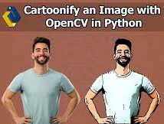
INTRODUCTION
In this, we will build one interesting application that will cartoonify the image provided to it. To build this cartoonifyer application we will use python and OpenCV. This is one of the exciting and thrilling applications of Machine Learning. While building this application we have used various libraries. Here you have to select the image and then the application will convert that image into its cartoon form. Mainly, we build this application using OpenCV and python as the programming languages.
The algorithm is designed to provide artistically and comically appealing results on a wide range of pictures as possible, although it is conceded that not all inputs yield equally satisfying results. Edge detection and the concept of filters have been used.

Slide 6
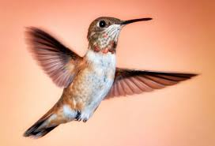
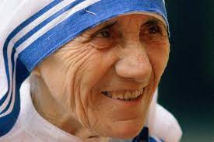
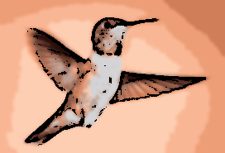
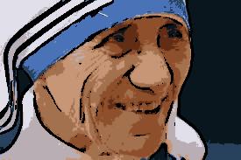

Slide 7
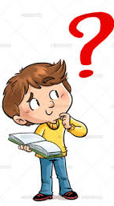
Why I have chosen this Project ?
The idea behind choosing this project was to create a cartoon from a picture. This project includes areas of vision (object recognition) and carnification. This was thought to be a step in helping the children to better understand and appreciate cartoons. Cartoons seem to be very familiar to children so they can relate to them.
Social media is extensively used these days. Standing out in this online crowd has always been a to-do for every user’s list on these social media platforms. Be it images, blog posts, artwork, tweets, memes, opinions, and what not being used to seek the attention of followers or friends to create influence or to connect with them on such social platforms. We aim to provide one such creative solution to their needs: applying cartoon-like effects to their images.

Slide 8
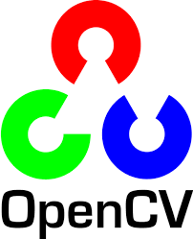

Description of the project
OpenCV: Python is the pool of libraries. One such library is OpenCV. OpenCV is a cross-platform library used for Computer Vision. It includes applications like video and image capturing and processing. It is majorly used in image transformation, object detection, face recognition, and many other stunning applications.OpenCV is an open-source library in python that is used mainly for computer vision tasks in the areas of machine learning and artificial intelligence. Nowadays, OpenCV is playing a major role in the field of technology. Using OpenCV we can process images and videos for some tasks like object detection, face detection, object tracking, and all. It supports all kinds of systems such as Windows, Linux, Android, Mac OS, IoS, and all.
Google Colab: Colab is a free Jupyter notebook environment that runs entirely in the cloud. Most importantly, it does not require a setup and the notebooks that you create can be simultaneously edited by your team members - just the way you edit documents in Google Docs. Colab supports many popular machine learning libraries which can be easily loaded in your notebook.

Slide 9
The process used for Cartoonify the Image
Step 1: Importing the required modules:
OpenCV, Numphy, OS, MATPOLIB
Step 2: Building a File Box to choose a particular File
Step 3: Transforming an image to grayscale
Step 4: Smoothening a grayscale image: using MedianBlur()
function
Step 5: Retrieving the edges of an image

Slide 10
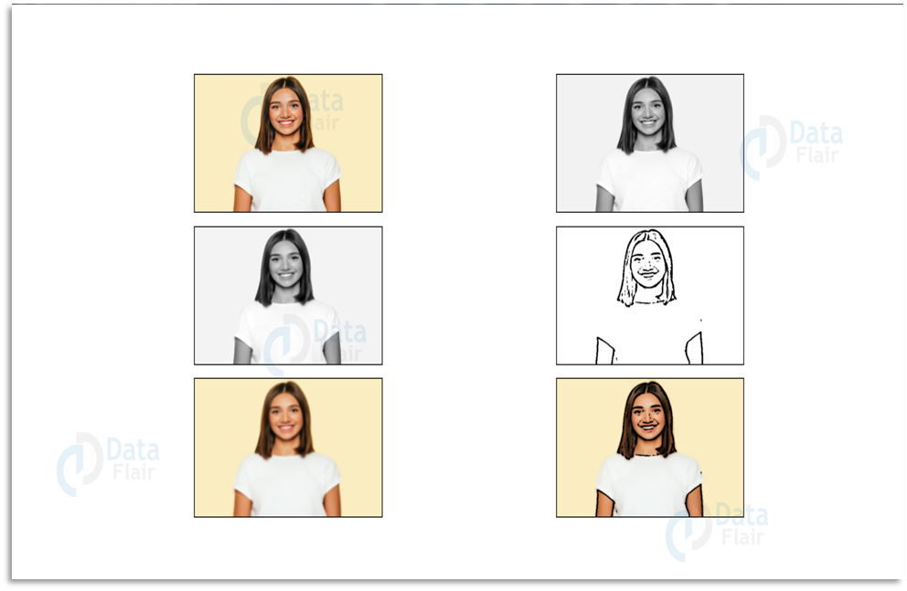
Step 6: Preparing a Mask Image The lightened color image that we mask with edges at the end produces a cartoon image. We use a bilateral Filter which removes the noise.
Step 7: Giving a Cartoon Effect
This will be done using MASKING. We perform bitwise and on two
images to mask them and by QR Code Scanner we can scan that image

Slide 11
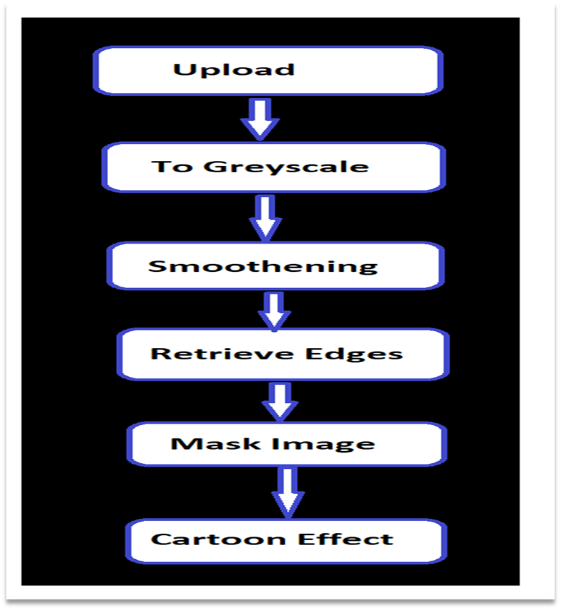
Flow Chart

Slide 12
SOME EXAMPLES OF PROJECT

Slide 13
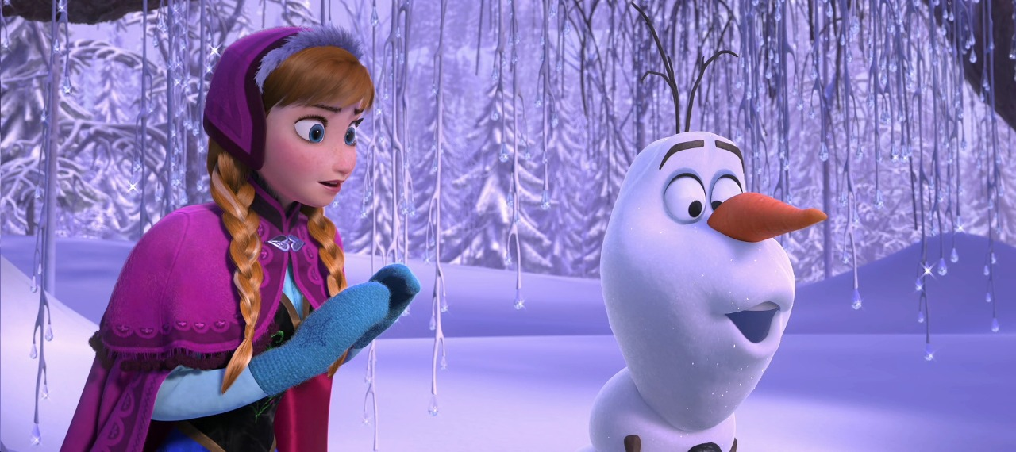
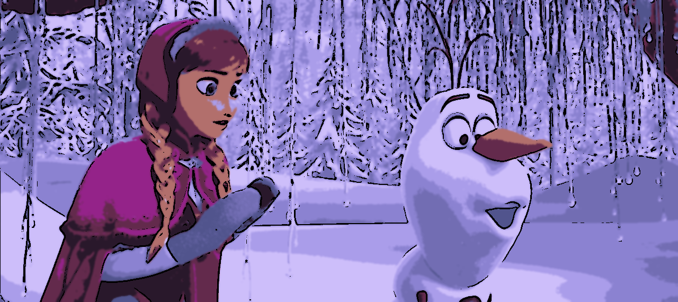
Original image
Cartoon image

Slide 14
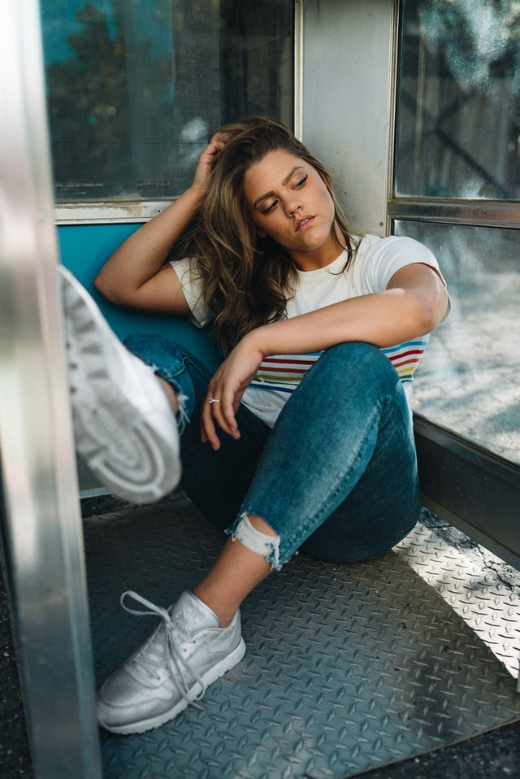
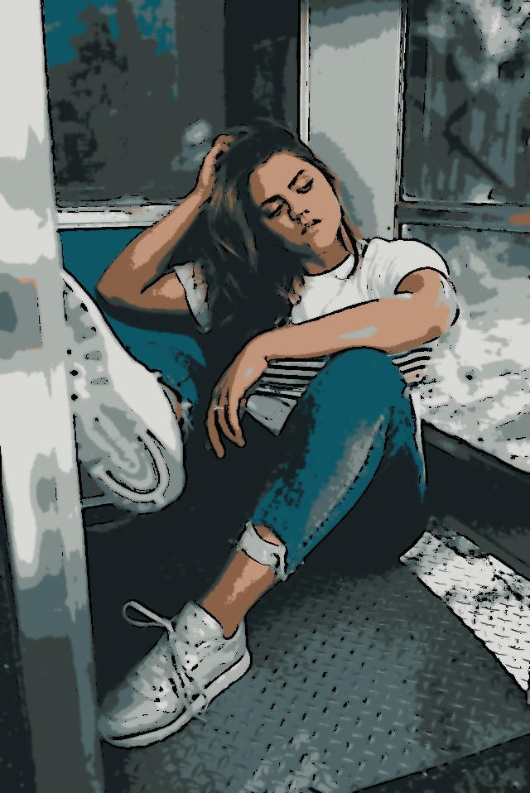
Original image
Cartoonify image

Slide 15
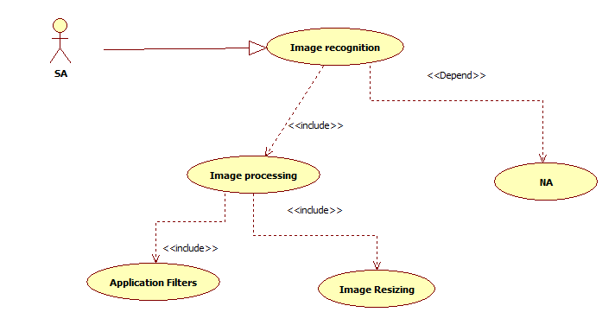
Use case diagram

Slide 16
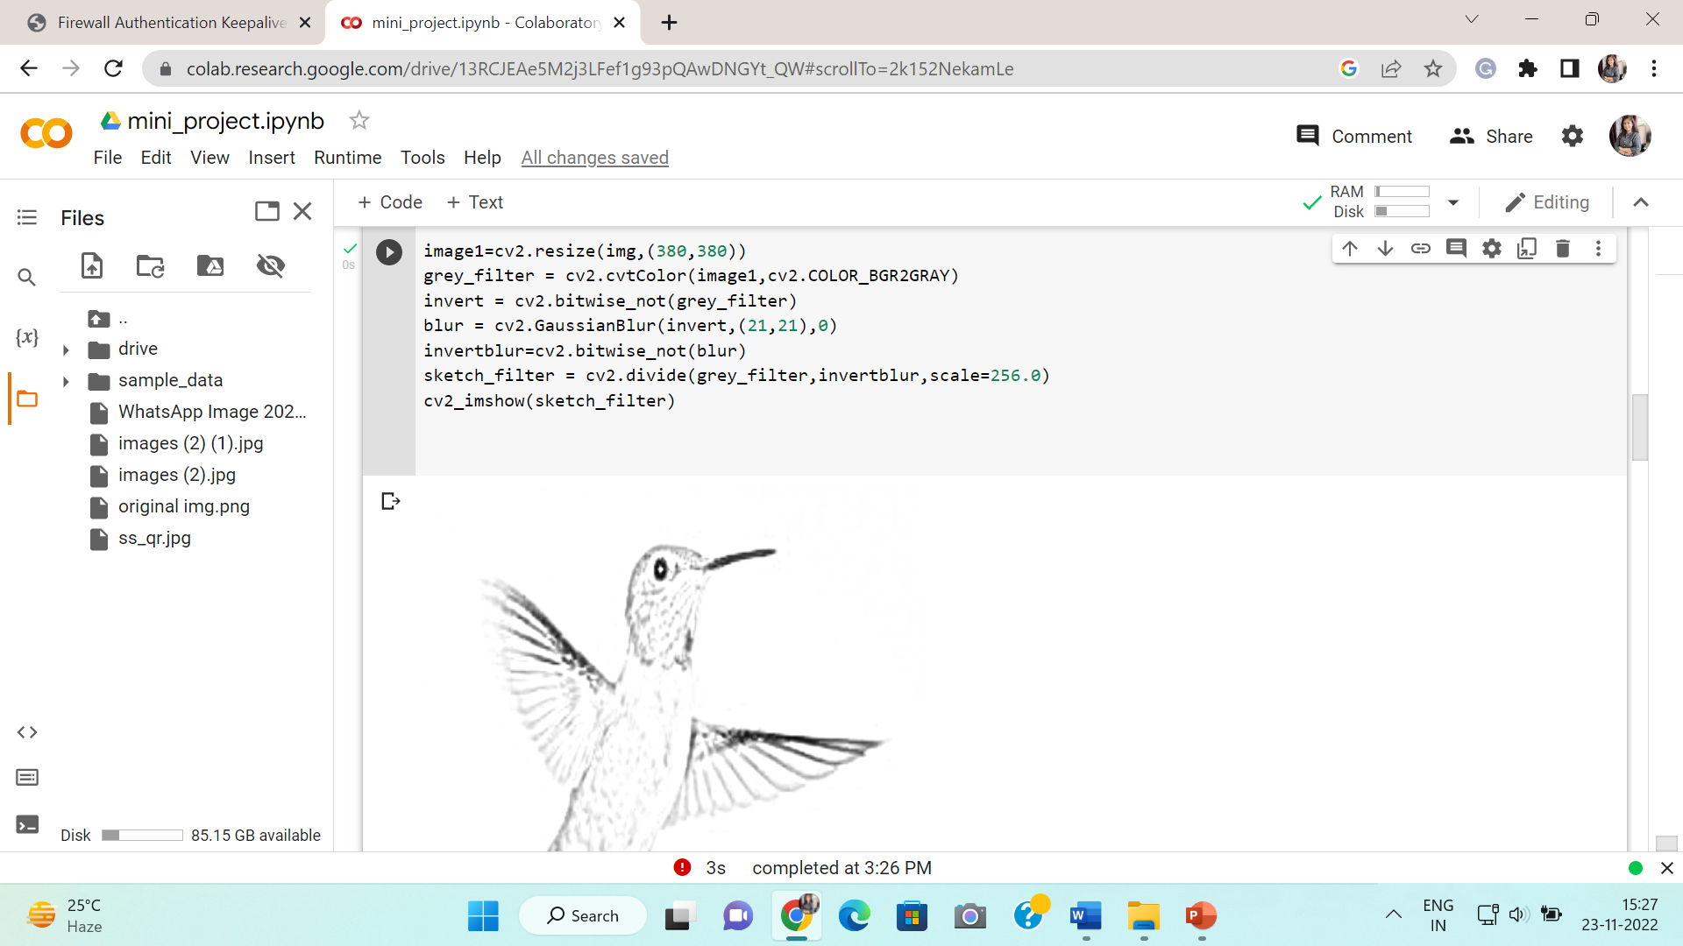
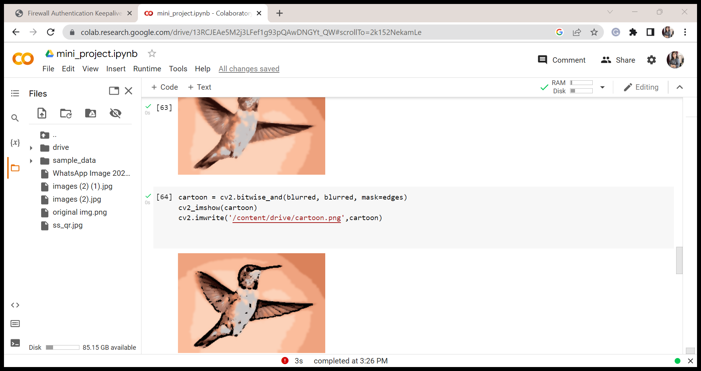
Some Screen Short of the project

Slide 17
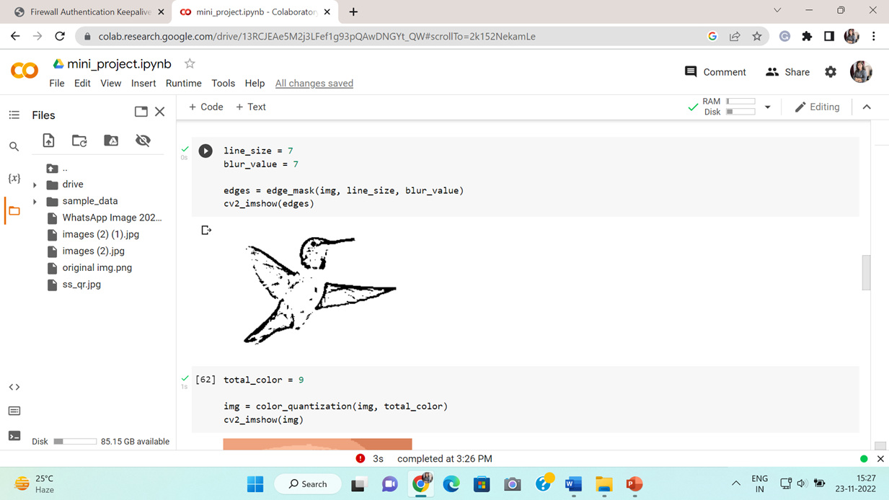
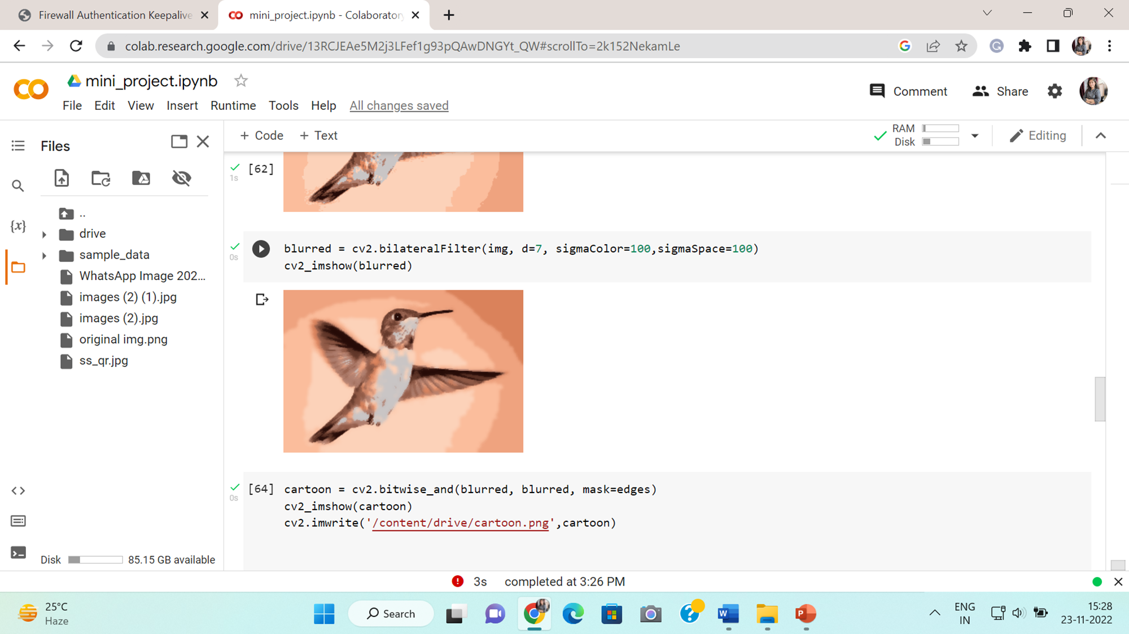

Slide 18
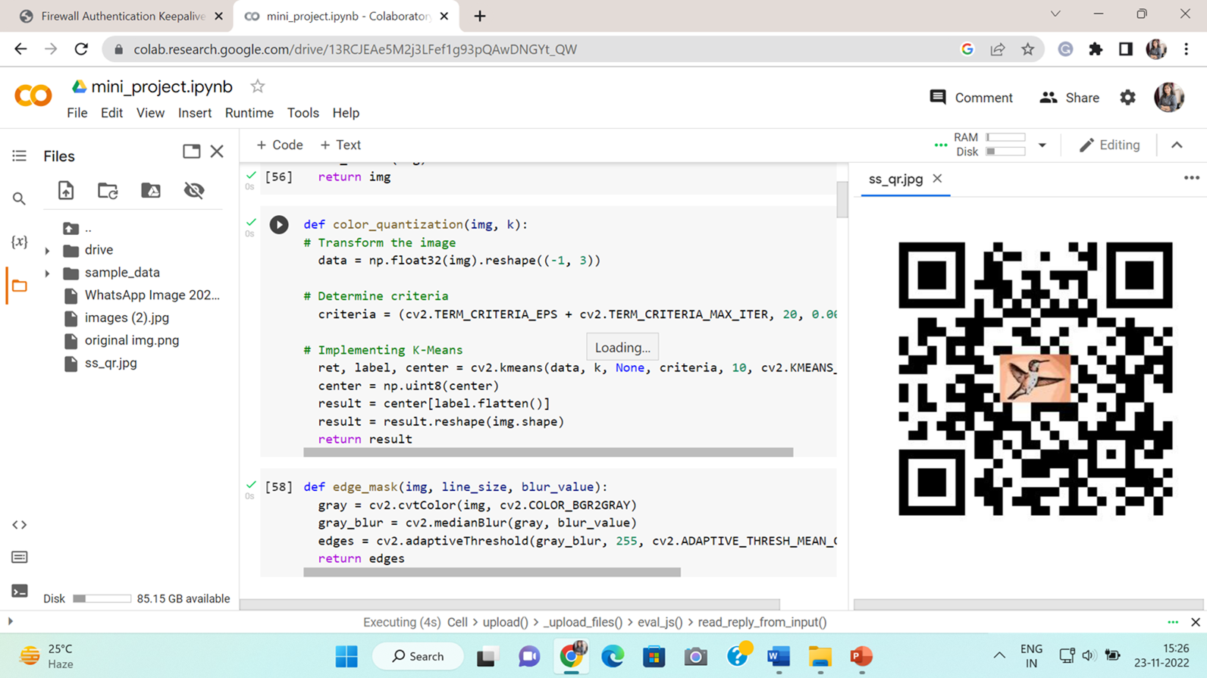

Slide 19
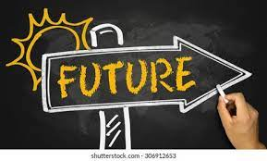
FUTURE PROSPECT
Currently, many systems are facing issues with face cartoonization. This can be improved by providing more facial data with different perspectives to the model. The resolution of the output also needs to be increased. In the future, we can apply these methods on the video to create a cartoon video. Social media is extensively used these days. We keep our online status updated every day, share photos and comments follow our friends’ news. To have a nice profile is a matter of prestige. You can use a photo of your own in a profile image, create an amusing avatar or turn your photo into a cartoon. With a pool of web applications available online, image conversion to a cartoon takes a few clicks.

Slide 20
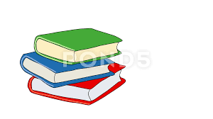


BIBLOGRAPHY
REFERENCES:
https://realpython.com/tutorials/advanced/
https://data-flair.training/blogs/cartoonify-image-opencv-python/
https://www.geeksforgeeks.org/best-python-libraries-for-machine-learning/
https://colab.research.google.com/ (platform used)
BOOKS:
https://www.javatpoint.com/digital-image-processing-tutorial
Deep learning with python and OpenCV by Viral Thakar

